Slide 1

Lesson 6-2
Turing Machines
Theory of Computation
王轩
Wang Xuan

Slide 2
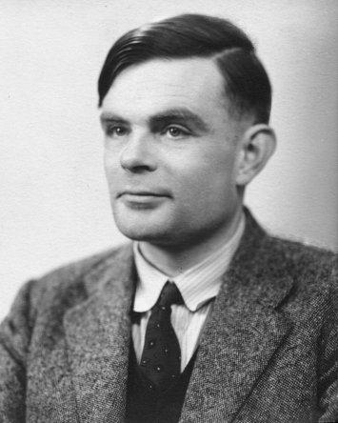
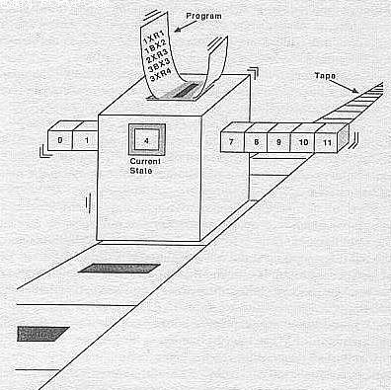
Outline
The Language Hierarchy
Automata-Recognizable language Table
Turing Machine
Halting & Accepting
Formal Definitions for Turing Machines
Turing Recognizable
Turing-decidable
Examples

Slide 3
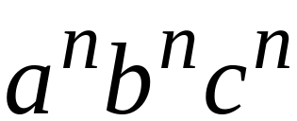

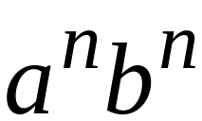



The Language Hierarchy
?
?
Context-Free Languages
Regular Languages

Slide 4
Languages accepted by
Turing Machines
Context-Free Languages
Regular Languages

Slide 5

Automata | Recognizable language
Deterministic finite automata (DFA) | regular languages
Nondeterministic finite automata (NFA) | regular languages
Regular languages Pushdown automata (PDA) | context-free languages
Linear bounded automata (LBA) | context-sensitive language
Turing machines | recursively enumerable languages

Slide 6
A Turing Machine
......
......
Tape
Read-Write head
Control Unit

Slide 7
Difference Between FA & TM
A Turing machine can both write on the tape and read from it
The read-write head can move both to the left and to the right
The tape is infinite
The special states for rejecting and accepting take effect immediately

Slide 8
The Tape
No boundaries -- infinite length
......
......
Read-Write head
The head moves Left or Right

Slide 9
......
......
Read-Write head
The head at each transition (time step):
1. Reads a symbol
2. Writes a symbol
3. Moves Left or Right

Slide 10






Example:
Time 0
......
......
Time 1
......
......
1. Reads
2. Writes
3. Moves Left

Slide 11



Time 1
......
......
Time 2
......
......
1. Reads
2. Writes
3. Moves Right

Slide 12
The Input String
Input string
Blank symbol
......
......
head
Head starts at the leftmost position
of the input string

Slide 13




States & Transitions
Write
Read
Move Left
Move Right

Slide 14
Example:
Time 1
......
......
Time 2
......
......

Slide 15
Example:
Time 1
......
......
Time 2
......
......

Slide 16
Halting
The outputs accept and reject are obtained by entering designated accepting and rejecting. If it doesn’t, it will go on forever, never halting.
The machine halts in a state if there is no transition to follow

Slide 17
Accepting States
Allowed
Not Allowed
Accepting states have no outgoing transitions
The machine halts and accepts

Slide 18
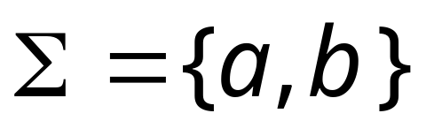
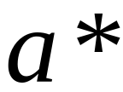


Turing Machine Example
Input alphabet
Accepts the language:
-> , L

Slide 19
Time 0
-> , L

Slide 20
Time 1
-> , L

Slide 21
Time 2
-> , L

Slide 22
Time 3
-> , L

Slide 23

Time 4
Halt & Accept
-> , L

Slide 24

Rejection Example
Time 0
-> , L

Slide 25
Time 1
No possible Transition
Halt & Reject
-> , L

Slide 26
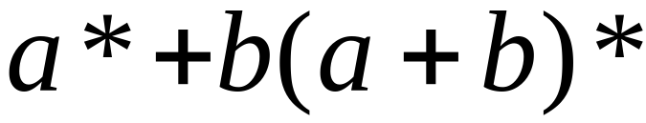

Infinite Loop Example
A Turing machine
for language
-> , L

Slide 27
Time 0
-> , L

Slide 28
Time 1
-> , L

Slide 29
Time 2
-> , L

Slide 30
Infinite loop
Time 2
Time 3
Time 4
Time 5

Slide 31
B={w#w|w∈{0,1}*}
M1=“on input string w:
  Zig-zag across the tape to corresponding positions on either side of the # symbol to check whether these positions contain the same symbol. If they do not, or if no # is found, reject. Cross off symbols as they are checked to keep track of which symbols correspond.
  When all symbols to the left of the # have been crossed off, check for any remaining symbols to the right of the #. If any symbols remains, reject; otherwise, accept.

Slide 32
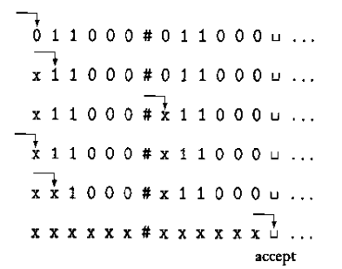
Turing machine M computing on input 011000#011000

Slide 33
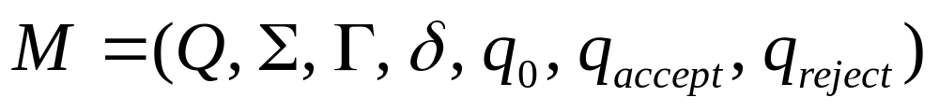
Turing Machine:
Input
alphabet
Tape
alphabet
States
Transition
function
Reject
states
Initial
state
Accept
states

Slide 34
Q is the set of states
Σ is the input alphabet not containing the blank symbol
Γ is the tape alphabet, where ∈ Γ and Σ ∈ Γ
δ: Q× Γ -> Q× Γ ×{L,R} is the transition function
q₀ ∈ Q is the start state
q_{accept} ∈ Q is the accept state
q_{reject} ∈ Q is the reject state, and q_{reject} ‡ q_{accept.}

Slide 35

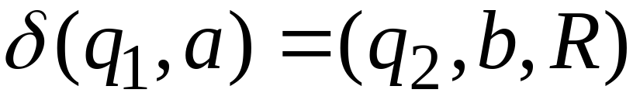
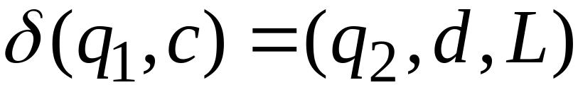
Formal Definitions for Turing Machines
Transition Function
Transition Function

Slide 36
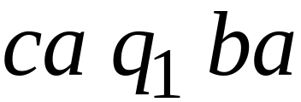
Configuration
Instantaneous description:
Configuration={current state, current tape
contents, current head location}

Slide 37


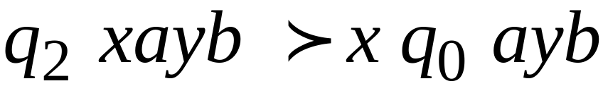
Time 4
Time 5
A Move:
(yields)

Slide 38
Time 4
Time 5
Time 6
Time 7
A computation

Slide 39
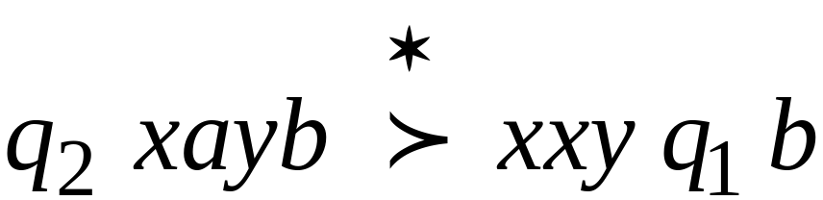
Equivalent notation:

Slide 40
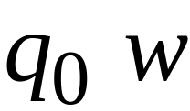

Initial configuration:
Input string

Slide 41

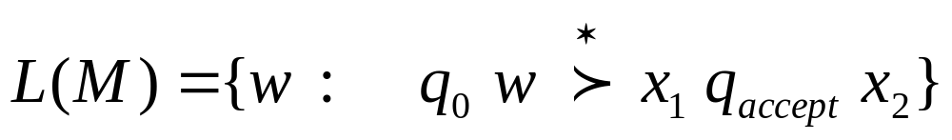
The Accepted Language
For any Turing Machine
Initial state
Accept state
The transition function
δ: Q’× Γ -> Q× Γ ×{L,R}, Q’ is Q without q_{reject} and q_{accept}

Slide 42
Definition:
Call a language
If some Turing machine recognizes it
Turing Recognizable
Other names used:
Turing Acceptable
Recursively Enumerable

Slide 43
A Machine may accept, or reject. These machines are called deciders because they always make a decision to accept or reject.
Call a language Turing-decidable or simply decidable if some Turing machine decides it.

Slide 44

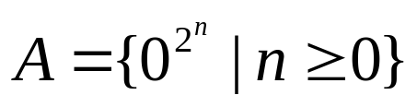
Example
Describe a Turing machine(TM) M that decides
The language consisting of all strings of 0s whose length is a power of 2
M = “ On input string w:
  1. Sweep left to right across the tape, crossing off every other 0 (隔一个)
  2. If in stage 1 the tape contained a single 0, accept.
  3. If in stage 1 the tape contained more than a single 0 and the number of 0s was odd, reject
  4. Return the head to the left-hand end of the tape
  5. Go to stage 1.

Slide 45
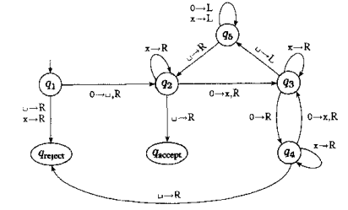
Explanation: each iteration of stage 1 cuts the number of 0s in half.

Slide 46
Input 0000
q¹0000

Slide 47
Input 0000
q¹0000
q²000

Slide 48
Input 0000
q¹0000
q²000
xq³00

Slide 49
Input 0000
q¹0000
q²000
xq³00
x0q⁴0

Slide 50
Input 0000
q¹0000
q²000
xq³00
x0q⁴0
x0xq³0

Slide 51
continue
.
.
.
.
xxxq²

Slide 52
accept
.
.
.
.
xxxq²
xxx q_{accept}

Slide 53
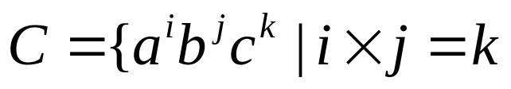

Example
Turing machine decide the language
and
M = “on input string w:
  Scan the input from left to right to determine whether it is a member of a⁺b⁺c⁺ and reject if it isn’t.
  Return the head to left-hand end of the tape

Slide 54
  Cross off an a and scan to the right until a b occurs. Shuttle between the b’s and the c’s, crossing off one of each until all b’s gone. If all c’s have benn crossed off and some b’s remain, reject.
  Restore the crossed off b’s and repeat stage 3 if there is another a to cross off. If all a’s have been crossed off, determine whether all c’s also have been crossed off. If yes, accept; otherwise, reject.

Slide 55
Review
The Language Hierarchy
Automata-Recognizable language Table
Turing Machine
Halting & Accepting
Formal Definitions for Turing Machines
Turing Recognizable
Turing-decidable
Examples

